Slide 1
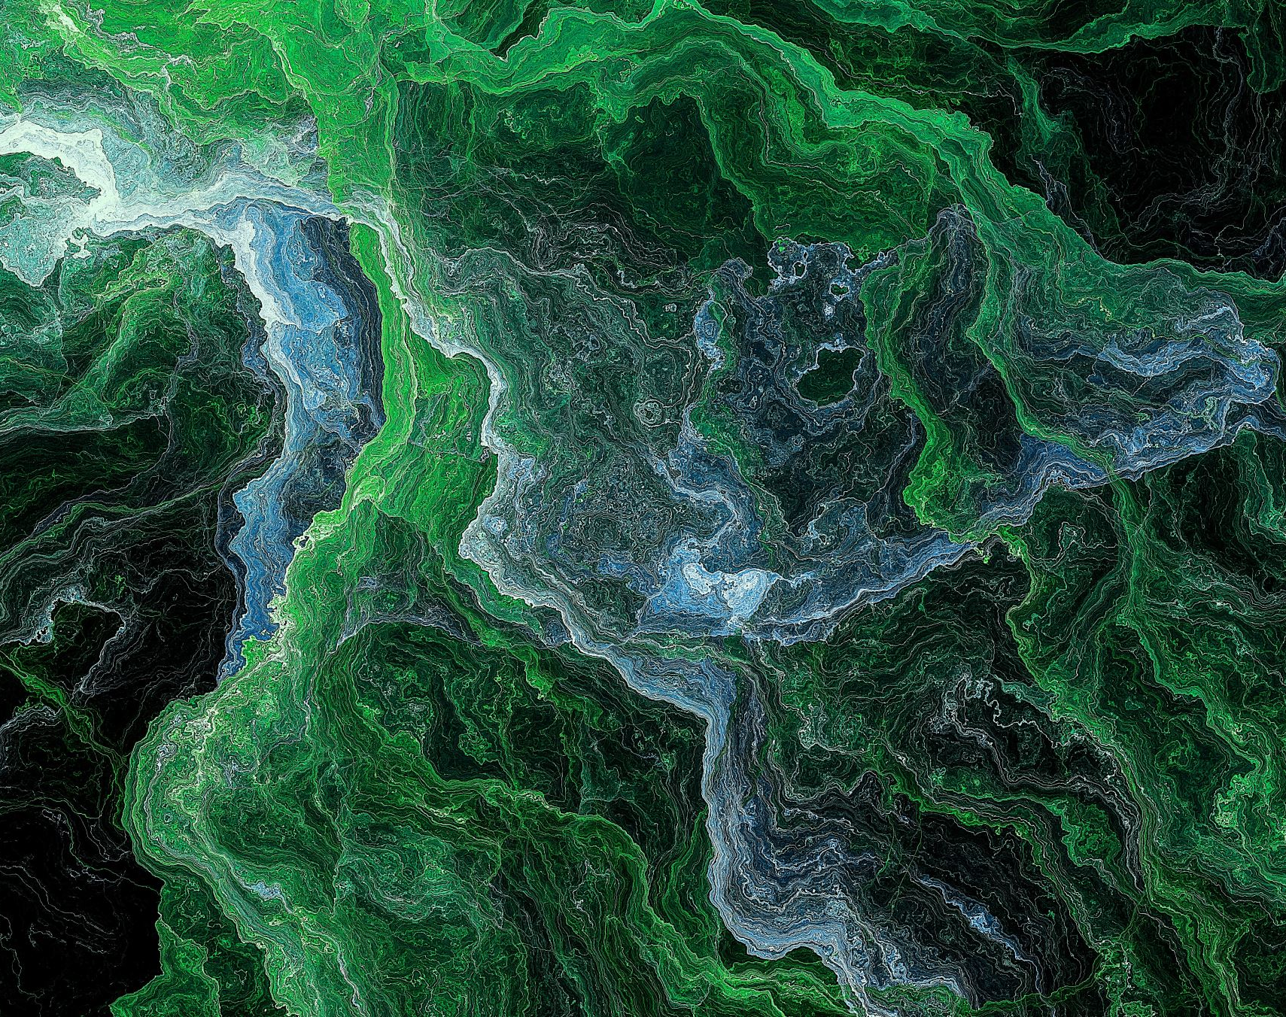
Harnessing the Power of Machine Learning: Enhancing Data Interpretation and Decision Making in an Uncertain World
Artin Majdi
Dept of ECE
July 28, 2023
Notes:
"Good afternoon everyone. My name is [Your Name], a PhD Candidate from the [Department Name]. I am delighted to present my doctoral dissertation today."

Slide 2
Introduction and Contextual Setting
Machine learning as a transformative tool
Applications across various domains
Advancements and challenges in machine learning
Notes:
"My dissertation focuses on the powerful tool of machine learning, which has delivered cutting-edge solutions to complex problems across diverse fields. However, despite its versatility and potential, machine learning still faces significant challenges. These challenges have served as the motivation for my research."

Slide 3

Underlying Motivation
Digital data surge and the need for innovative strategies
The promise and persisting issues in machine learning
The focus on model and data uncertainty
Notes:
"In this era of digital data explosion, the demand for innovative strategies for data analysis is on the rise. While machine learning has been instrumental in addressing this demand, certain issues persist. My work aims to delve deeper into these issues, focusing on how we can account for uncertainty in model predictions, a critical factor in enhancing machine learning effectiveness."

Slide 4

Problem Statement
Complexity and variability in real-world datasets
Unique challenges for each machine learning application
Need for advanced, resilient, and precise computational methods
Notes:
"The core problem that my dissertation addresses is the inherent complexity and variability of real-world datasets. Despite the diverse nature of the problems discussed in this dissertation, they all highlight the need for advanced computational methods capable of effectively handling and analyzing large, complex datasets."

Slide 5
Research Objectives
Proposing novel machine learning methods for each problem area
Improving accuracy, efficiency, and robustness of data interpretation
Leveraging label aggregation, taxonomic structures, and high contrast medical images
Notes:
"My research introduces and assesses new machine learning methodologies for each of the problem areas, with the aim of enhancing the accuracy, efficiency, and robustness of data interpretation. Specifically, I aim to improve label aggregation techniques, devise more accurate classification methods, develop robust techniques using less common high contrast medical images, and establish automated processes for detecting driver distraction and classifying primary cilia."

Slide 6

Research Queries
Enhancing reliability of crowdsourced labeling and ensemble learning
Leveraging taxonomic structure for precise diagnosis
Utilizing common data modalities to improve accuracy of less frequent ones
Employing transfer learning for detecting driver distraction and classifying primary cilia
Notes:
"Throughout this research, I aim to answer several pivotal questions, such as how can we increase the reliability of crowdsourced labeling, how can we boost the precision of diagnosis by leveraging the taxonomic structure of medical pathologies, and how transfer learning can be utilized to effectively detect and classify driver distraction as well as primary cilia."

Slide 7
Methodology Synopsis
Unique methodology for each chapter
Different machine learning techniques applied
Comparison with existing techniques
Notes:
"Each chapter of my dissertation proposes a unique methodology developed to tackle its respective problem. I have used a variety of machine learning techniques, including label aggregation, hierarchical multi-label classification, cascaded multi-planar schemes, and convolutional neural networks fused with random decision forests. I have also compared the efficacy of each method with existing techniques."

Slide 8
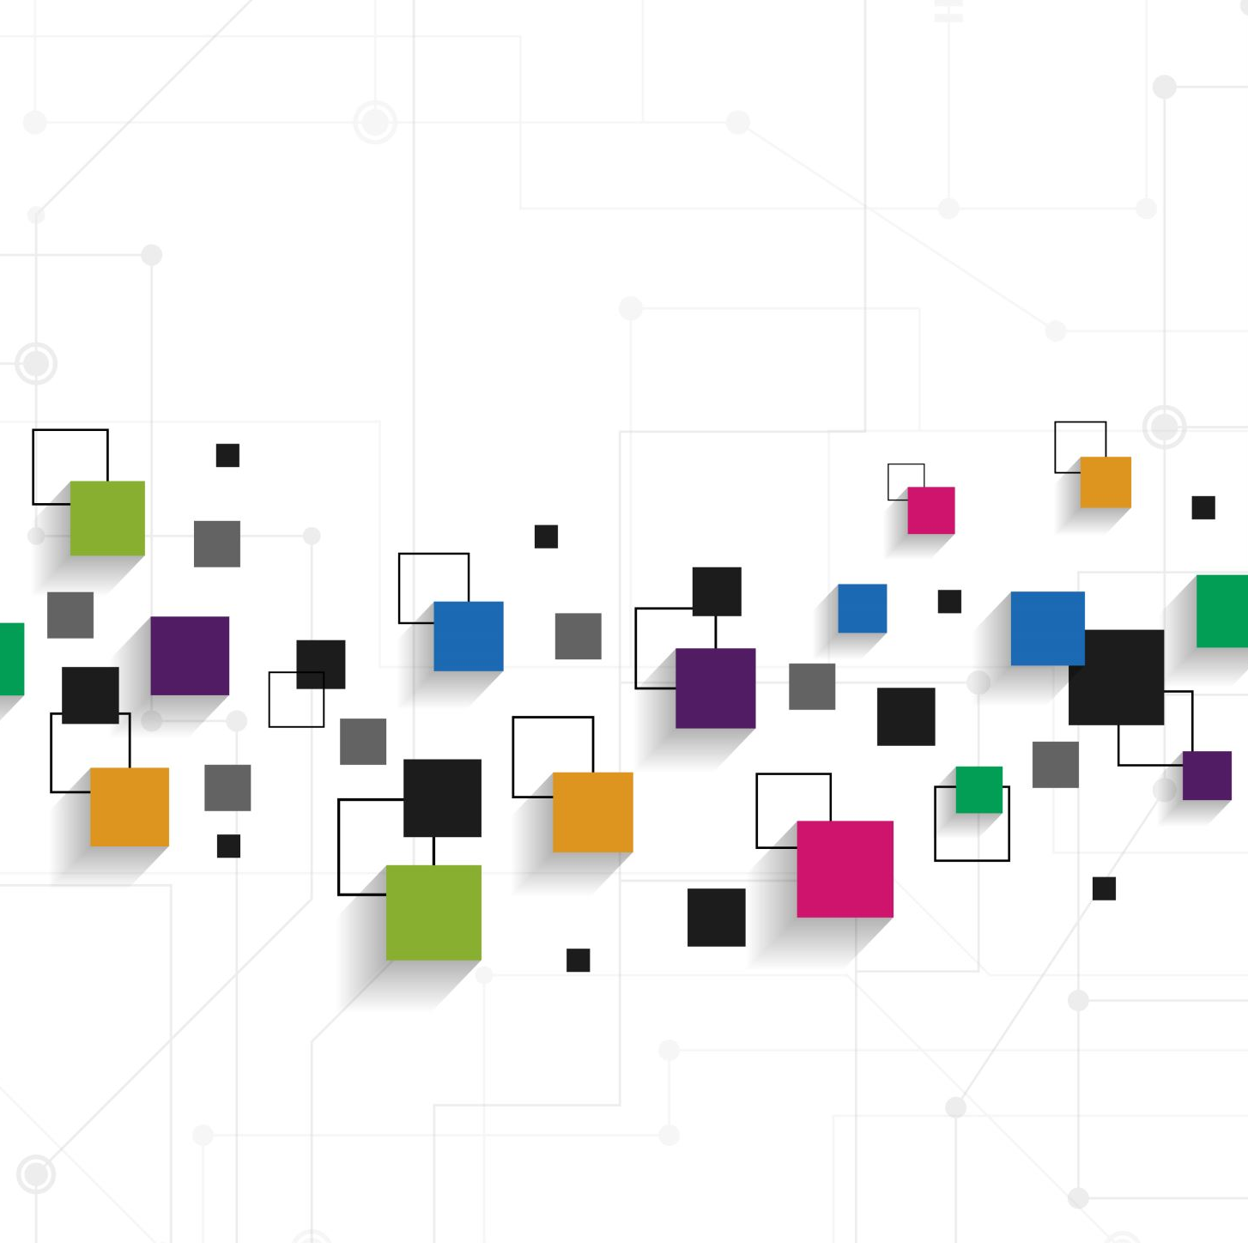
Scope and Limitations
Broad spectrum of machine learning applications
Evaluation on specific datasets
Scalability and adaptability of methods
Notes:
"While the methods introduced in this dissertation can be generalized, their evaluations are carried out on specific datasets. Therefore, the findings and conclusions are subject to the constraints and properties of these datasets. Nonetheless, these proposed methods are scalable and adaptable, hinting at their wider application in the future."

Slide 9
Dissertation's Organization
Chapter 1: Crowd-Certain for robust label aggregation
Chapter 2: Hierarchical Multilabel Classification for thoracic disease diagnosis
Chapter 3: Automated Thalamic Nuclei Segmentation using CNN
Chapter 4: Drive-Net for driver distraction detection
Chapter 5: Classification of Primary Cilia using Convolutional Neural Random Forests
Notes:
"The dissertation is organized into five chapters, each dealing with a unique problem area and proposing novel machine learning methods to address these issues. From the development of the Crowd-Certain method for robust label aggregation to the use of CNN and a Random Decision Forest for driver distraction detection, my dissertation traverses a variety of domains and machine learning applications."

